Slide 1

-E
Team : BUET_SKAMmers
Araf Mustavi, Subangkar Karmaker

Slide 2
Learner
Instructor

Slide 3
Existing System
Absence of Quality Assurance
Absence of Quality Feedback
1
Teachers Deliver Lectures
Less Attentive
Students Respond with Queries
2
Student
Teacher
3
Teacher Respond with Answers
No Experimental
Techer Student Interaction

Slide 4
Problem statement
The problems we found in the existing system is:
Less-efficient Interaction
No effective system to track student’s attention holding rate
Scarcity of Experiment resources
We plan to solve these problems by introducing
an AR assisted Virtual Lab system that will help to increase interaction and Experiment Run down

Slide 5




.
.
.
.
.

Slide 6

.
Netflix and Foreign Video Streaming Portals in Bangladesh

Slide 7
Modules
AR Lab
Class Lecture Generator
Continuous Video Monitor
Image Processing of Webcam

Slide 9
Use Case,
Activity Diagram,
Data Flow Diagram,
Architecture Diagram

Slide 11

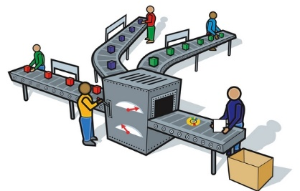

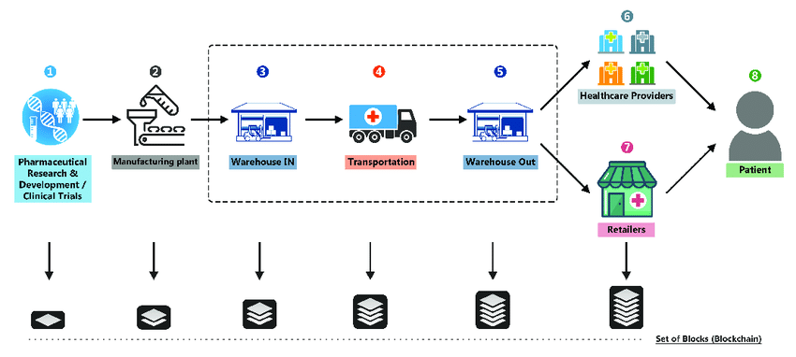

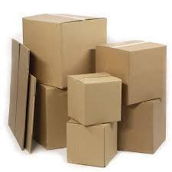
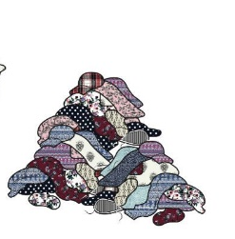

Proposed System
9
Pays the Bill
Trx info
Tax Department
Smart Contract between Buyer and Manufacturer
2
Supplies goods for production process
1
Manufacturer
Buyer
Supplier
Payable Tax Information for Transparency
Information about supplier and supply details
Product Information and Date of Arrival/ leaving
8
Receives
Order
Information about Buyer and Manufacturer , contract details
Unused ‘waste’ for
Reuse within supply chain
3
Production
Product movement along the production chain
7
Buyer Warehouse
Block Chain
Produced Waste Information
Miners
Small Scale Supplier
Waste Information for Low Cost Medical Equipment
6
Transportation
5
Manufacturer Warehouse
4
Finished Goods
Waste
Hospital

Slide 12
Proposed System
9
Pays the Bill
Trx info
Tax Department
Smart Contract between Buyer and Manufacturer
2
Supplies goods for production process
1
Manufacturer
Buyer
Supplier
Payable Tax Information for Transparency
Information about supplier and supply details
Product Information and Date of Arrival/ leaving
8
Receives
Order
Information about Buyer and Manufacturer , contract details
Unused ‘waste’ for
Reuse within supply chain
3
Production
Product movement along the production chain
7
Buyer Warehouse
Block Chain
Produced Waste Information
Miners
Small Scale Supplier
Waste Information for Low Cost Medical Equipment
6
Transportation
5
Manufacturer Warehouse
4
Finished Goods
Waste
Hospital

Slide 13

Problem’s in Existing International system (Bangladesh context)
Foreign Currency Based Transaction System
Low Number of plastic card user
1
User Applies for Subscription
using Credit/Debit Card
Server Cross-checks with Card’s Identity by refundable $01
2
3
Server confirms the account
creation
User
4
User gets access to contents
4
User gets contents on demand
Overall poor marketing
Lack of Local Culture Oriented Contents
Fig : Video Streaming Systems process map

Slide 14
Analysis of Problems
I${nternet User}^{[1]}$
I〖nternet User〗^([1])
100 Million
13 Million
P${lastic Card User}^{[1]}$
P〖lastic Card User〗^([1])
Plastic Money User and Market in Bangladesh:
The number of plastic card user in Bangladesh is very low compared to the number of people with access to internet.
People performs most paperless money transfer activities either by mobile recharge or local currency transaction handler like Bkash or Rocket.
Even the new local startups related to monetary transaction (Like iPay , Dmoney , SureCash) are having a tough time to penetrate the market
Due to Expensive Subscription policy, people prefer piracy over buying account as the subscription fee is not affordable for maximum users in Bangladesh
So a new foreign money transaction based subscription system dedicated for Netflix or any other Foreign Video Streaming portal will not be an initial success

Slide 15
Analysis of Problems
Local Culture and Audience Based Categorization of Contents:
Most contents are in foreign language like English
Majority of the old aged people prefer contents in Bangla
Presence of exclusive contents according to age category and target audience can help Foreign Video Streaming Vendors to have a breakthrough in domestic market

Slide 16
Solution
People will subscribe only if there is an easy process through local currency. For a successful penetration in Bangladesh Context, they will have to adopt a collaborative eco-system with local money transaction handlers and mobile operators.
Under contract, Foreign Video Streaming Vendors can ask local currency transaction handler(Bkash/Rocket/Nagad etc) and mobile operators to have a special scheme for them. The proposed scheme is:
Instead of plastic card, people registers using mobile number.
People will pay in local currency with the help of local currency transaction handler
Foreign Video Streaming vendor will receive the money in Dollar
In return they would share a portion of their revenue with the local currency handler

Slide 17
Task 02
Challenges for Local Video Streaming Companies in Bangladesh

Slide 18
Present Scenario
Before diving into the solution, we need to understand the mindset and present eco-system of local people towards Digital Entertainment
Source of Digital Entertainment
Cable Tv
Social Media
YouTube
Major Source of Entertainment
Popular with the Housewives
Genre: Drama
Cheap
Easily Available
Source of Entertainment for people with internet access
Popular with the Teenagers
Thriller and Trends get more attention
Cheap
Easily Available
Requires good internet access speed
Popular with almost everyone
No specific Genre
Easily Available

Slide 19
Present Scenario
Traditional Cable TV users are the majority of the people and most of them are not aware about the contents of Local Video Streaming Vendors like BongoBD/Bioscope
They are accustomed to watching contents in TV rather Smart Devices
Absence of suitable content according to category is a major problem while trying to attract a mass group of people
Users in the rural area do not get strong seamless internet to begin with
Absence of frequent local ISP coupling with expensive data pack makes the outreach of Local Video Streaming Vendor to mass people a problem

Slide 20
Problem Identification
The problem with the existing system can be identified as follow
Less efficient marketing strategy
Digital contents aiming a certain group of audience
Absence of User Friendly Subscription system
Expensive data packs by mobile operator
Content length based on user’s device
Using age old of non smart-TV
Hassle in payment system
Now we dive into the solution addressing every problem point.

Slide 21
Proposed solution : Marketing Strategy
At first, people need to acknowledge the existence of local video streaming portal. To do so, the demand generation is an important thing.
An effective marketing strategy can be as per follow:
Posting ads in Social Media about the contents
Sponsoring the contents of YouTube vlog/videos
Collaboration with e-commerce websites to offer Free subscription towards people who are comfortable with e-commerce
Posting ads Digital Billboard and Public Widescreen(Like the one existing in Shah Bagh)
Arranging events in school and college
Impact
Increased Traffic in Portal
Generation of interest among people
Creating potential future customer

Slide 22
Proposed solution : Target Audience Based Content
Most of the contents available in the video streaming portals are made targeting the people withing age group 14-30 . But a major portion of the elderly audience as well as the children can also be attracted with properly designed content as per below:
Children
Elderly People
Cartoon and thriller anime can attract a good number of user into using the portal
Educational Cartoon Contents in Bangla for kids will also let parents to have a relief about what to choose the babies
Building interest among school going students by contents aimed for them will help to expand the portal’s fame
Religious contents like talks of famous Islamic Scholar can attract a potential pious aged audience
News and documentary in Bangla language can hold the attention of matured people

Slide 23
Proposed solution : Collaborative eco-system
Most subscription system uses Card Based Payment Method, some uses Local Currency Transaction Handler like Bkash/Rocket/Nagad
To make the transaction for subscription easier, the Streaming Portals can have a collaboration with the local mobile operators. The system will function as per follow.
People recharge balance in their mobile account/Digital Banking Account
Streaming portals offer scheme according to their policy
People choose their desired scheme
Amount is deducted from mobile/Digital Banking Account balance
Monetary transaction using Bkash Account has a taboo within the typical user. But this method is comparatively User Friendly as he can buy subscription the way he buys data pack.

Slide 24
Proposed solution : Collaborative eco-system
Bangladesh has more of Mobile Data based user other than ISP user.
So , the collaborative eco-system should offer special data pack from the mobile operators dedicated to the usage of Stream Portals
Doing so, we can attract a lot of mobile data based internet user to the stream portal.

Slide 25
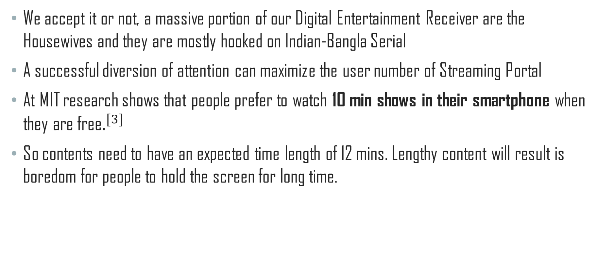
Proposed solution : Content Length
We accept it or not, a massive portion of our Digital Entertainment Receiver are the Housewives and they are mostly hooked on Indian-Bangla Serial
A successful diversion of attention can maximize the user number of Streaming Portal
At MIT research shows that people prefer to watch 10 min shows in their smartphone when they are free$.^{[3]}$
So contents need to have an expected time length of 12 mins. Lengthy content will result is boredom for people to hold the screen for long time.

Slide 26
Proposed solution : Conversion into smart-TV
For an 18 months subscription scheme, the Streaming Portals can offer TV-Box to its user as a gift.
This has a long-term effect
People can convert their age-old traditional TV into smart TV
They are likely to browse internet and watch contents in their converted smart TV
With potential quality contents, the process can grab the attention of more customers.

Slide 27
Additional Endeavour
The Stream Portals can create a hype by content review contest in the social media. This will give a boost to their content and they can get user feedback to modify future contents accordingly
Setting up temporary stalls in festivals to offer fee premium contents to students as a part of marketing can help to popularize their portal

Slide 28
Conclusion
The local people of Bangladesh is still not ready to change their existing digital entertainment method.
So any video streaming portal trying to make any penetration in the market is likely to face a difficult environment to overcome.
But this difficult environment is not impossible to overcome , Uber and Pathao has showed that it is possible to create a market by introducing app based transport system in the cities.
Proper marketing, quality contents targeting audience and ambience is the key factor to success

Slide 29
References
[1] https://www.thedailystar.net/online/top-internet-using-country-2017-in-asia-bangladesh-5th-1643752
[2] https://www.mutualtrustbank.com/wp-content/uploads/2018/07/MTBiz-May-June-2018-.pdf
[3] http://web.mit.edu/bentley/www/papers/mobileVideoCHI.pdf

